Slide 1

EPA Business Analysis

Slide 2
Meet the Team
Year
Major(s)
Skillset Used
Andrew Kim
Python, Machine Learning
Sophomore
Accounting and ISBA
Sam Winter
Tableau, Data Visualization
Junior
ISBA
Graham Olson
Excel, Data Analysis
Senior
ISBA
Sam Nielsen
Data Analysis,
PowerPoint
Junior
Finance and ISBA
Introduction | Intro to the Dataset | Data Visualization | Data Analytics | Predictive Analytics | Conclusion

Slide 3
Table of Contents
Intro to the Dataset
Data Visualization
Data Analytics
Predictive Analytics
Introduction
Analysis Question
Data Preparation
NA values, Separating Data, Missing Data
Data Preparation
Training, Testing, CrossValidation, Gridsearch
Process
Visualize the impact of Contract Awards
Objective #1
Software Used
Why and how they were utilized
Python
Descriptive Statistics, Groupby and AGG functions
Feature Importance
R Squared and Coefficients
Tableau
Visualize attributes, filtering, & Dashboards
Objective #2
Introduction | Intro to the Dataset | Data Visualization | Data Analytics | Predictive Analytics | Conclusion

Slide 4
Introduction
What factors effect funding that minority women owned small businesses receive and how can they tailor their application to receive more funding?
Introduction | Intro to the Dataset | Data Visualization | Data Analytics | Predictive Analytics | Conclusion

Slide 5
Stakeholders
EPA and Small Minority Owned Businesses
EPA
Focus on Helping underrepresented groups generate more funding
Support small economies and businesses
State specific insights
Small Minority Owned Businesses
How to tailor their application
Which States are most supportive of small businesses
Understanding of important features
Introduction | Intro to the Dataset | Data Visualization | Data Analytics | Predictive Analytics | Conclusion

Slide 6
Software Used
Objective #1 Visualization
Showcasing the impact of awards onto specified groups, and highlighting the importance of certain attributes on contract award value
We were already familiar with Tableau, and it allowed us to produce insightful interactive visualizations quickly to perform rudimentary data analysis
Tableau
Objective #2 Analytics
Cleaning Duplicate values, NA Values, and Replacing Values
Libraries such as Numpy, Pandas, SK.learn, and Matplot.Lib
We All felt more confident using Python due to the speed in which we could perform analysis when compared to excel and the usability compared to SQL
Python
Introduction | Intro to the Dataset | Data Visualization | Data Analytics | Predictive Analytics | Conclusion

Slide 7
Process
Screening
Execution
We wanted to gauge the broad view of award money distribution
Also try to pinpoint certain attributes that may increase or decrease contract awards
Visualize the differences between groups with same attributes
Decided to showcase contract distribution via pie chart
Mapped out contract awards by states, to gauge what states prefer certain groups over others
Showcase the differences with a geographic map of contracts per group
Introduction | Intro to the Dataset | Data Visualization | Data Analytics | Predictive Analytics | Conclusion

Slide 8
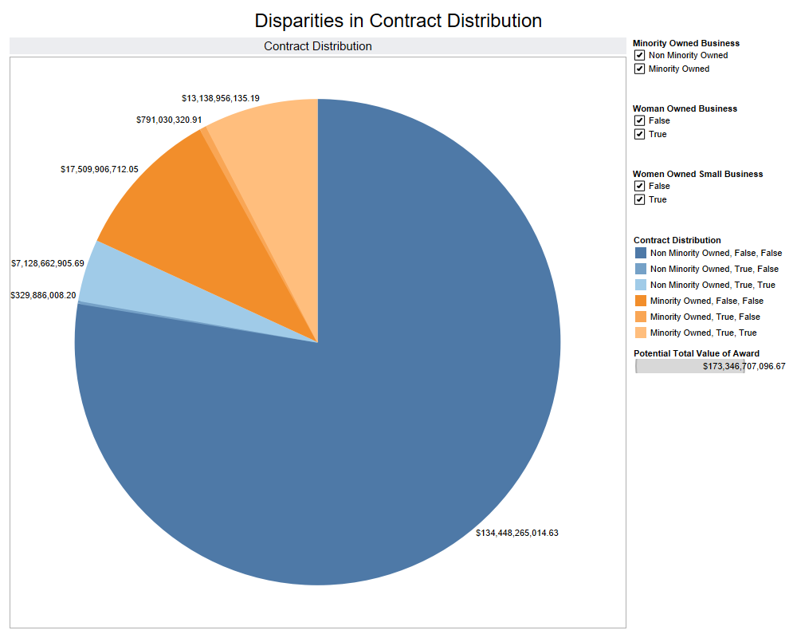
Tableau
Introduction | Intro to the Dataset | Data Visualization | Data Analytics | Predictive Analytics | Conclusion

Slide 9
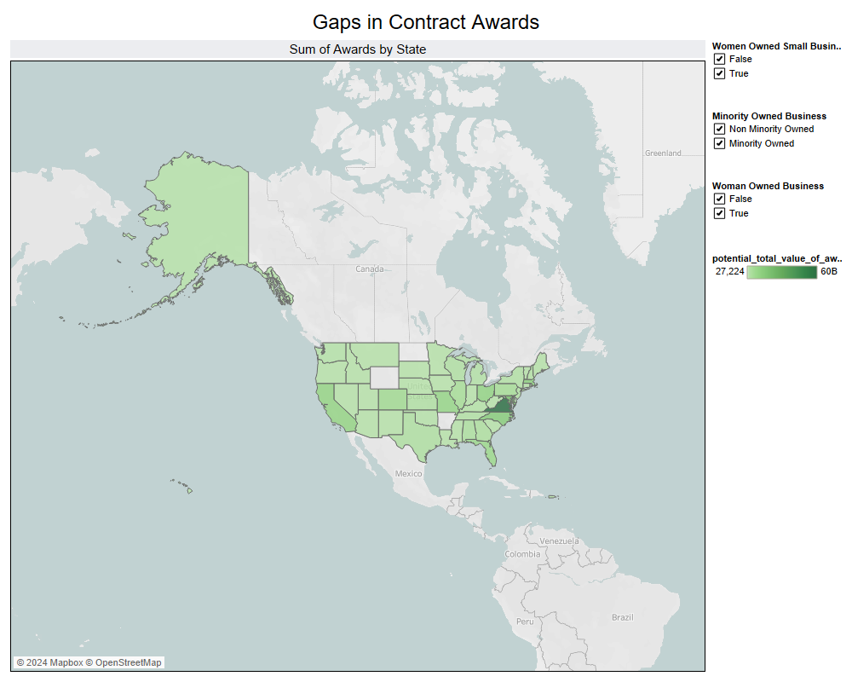
Tableau
Introduction | Intro to the Dataset | Data Visualization | Data Analytics | Predictive Analytics | Conclusion

Slide 10
Data Preparation
Initially checked for duplicate rows but as we investigated further, we found a high amount of NA values
To counteract this, we used a threshold of 80% on the columns and 75% on the rows to drop missing data
Duplicate Values
To perform analysis on our specified groups, we created new Data Frames to separate and compare the data.
We organized the data off the object data type and kept Float64 and Int64 to perform analysis on.
Data Frames
We noticed that despite cleaning the data, there were missing values in the columns.
We decided to use the mode to consider the “extreme” values instead of just using the median
Filling NA values
Introduction | Intro to the Dataset | Data Visualization | Data Analytics | Predictive Analytics | Conclusion

Slide 11
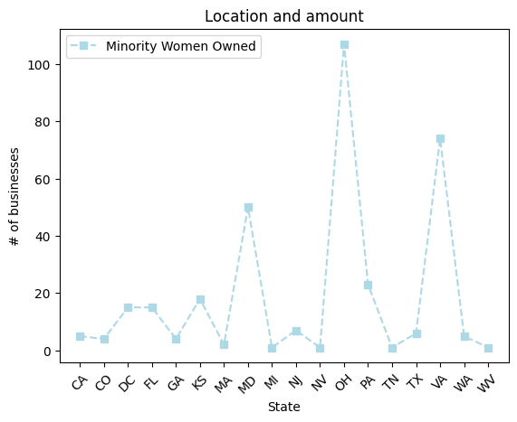
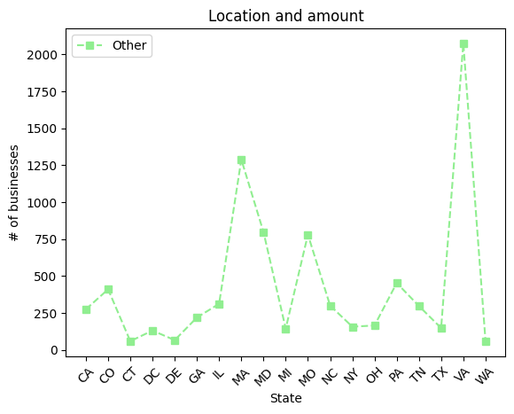
Python
Introduction | Intro to the Dataset | Data Visualization | Data Analytics | Predictive Analytics | Conclusion

Slide 12
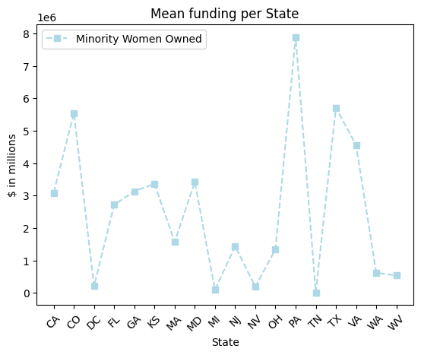
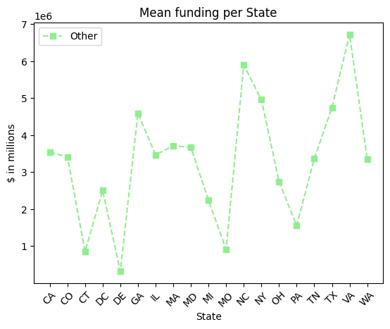
Python
Introduction | Intro to the Dataset | Data Visualization | Data Analytics | Predictive Analytics | Conclusion

Slide 13
Data Preparation
Training and Testing:
Assigned X and Y variables
Used Train Test Split into an 80/20 ratio
Utilized a Correlation Matrix to solve for Multicollinearity
GridSearch:
Implemented hyper parameter tuning through “Alpha”
Cross Validation set to 10
Scoring was based on R2 values
Modeling:
Used Ridge and Lasso Models to determine Feature Importances
Sorted the coefficients on MatplotLib.pyplot
Comparison between the Coefficients between the models
Introduction | Intro to the Dataset | Data Visualization | Data Analytics | Predictive Analytics | Conclusion

Slide 14
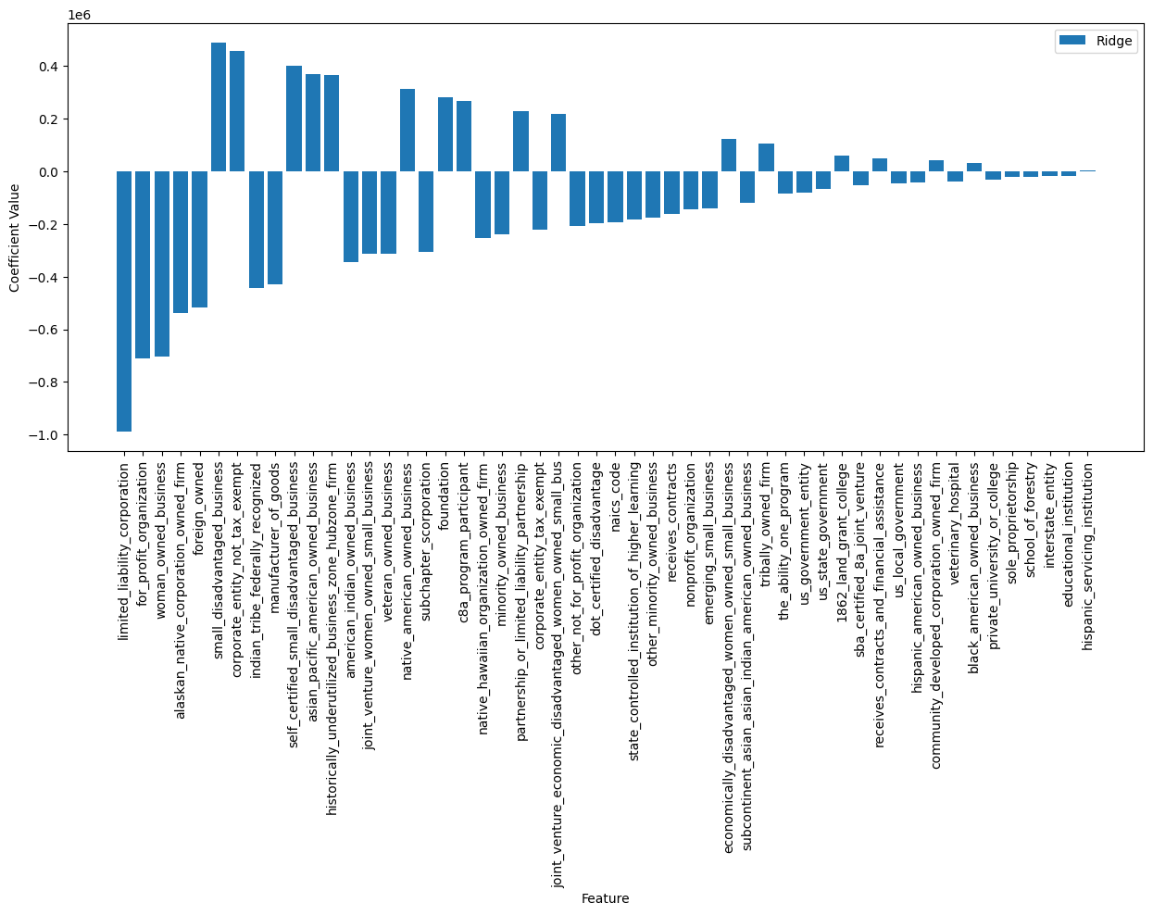
Feature Importance
Introduction | Intro to the Dataset | Data Visualization | Data Analytics | Predictive Analytics | Conclusion

Slide 15
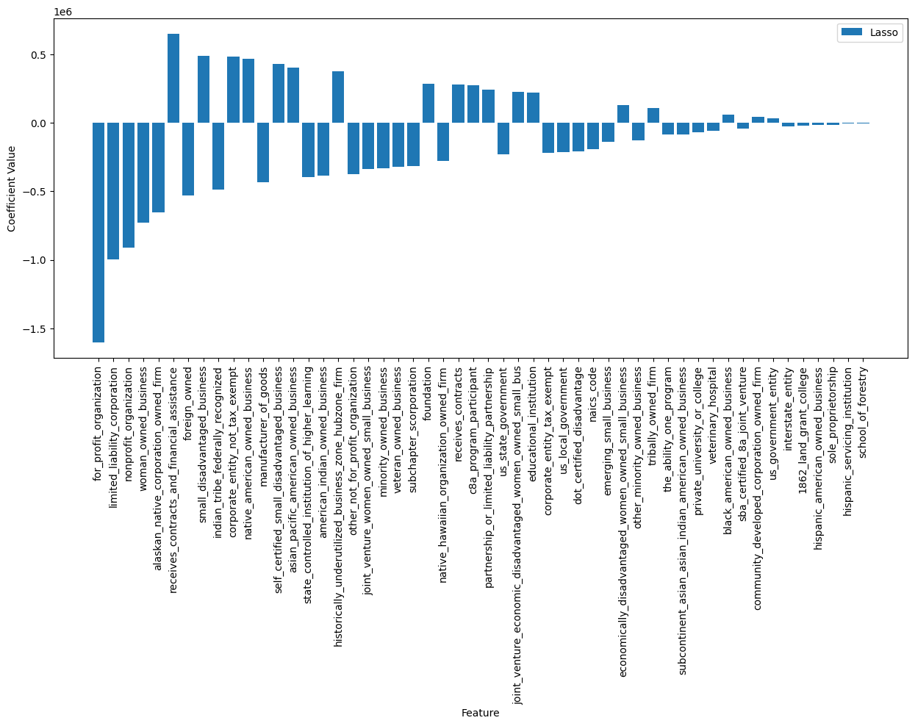
Feature Importance
Introduction | Intro to the Dataset | Data Visualization | Data Analytics | Predictive Analytics | Conclusion

Slide 16
Insights
Take away 1:
Take away 2:
Programs you can be involved in
C8A nine - year training program
Hub Zone – historically underutilized locations
Self certification and statement of small disadvantage business
High correlation of receiving funding for these businesses based on regression models
Take away 3:
Take away 4:
Success based on geographical location between states
Ohio & Virginia approved a higher percentage of minority women
Not enough data to verify attributes that help women and minority women owned businesses
Out of all the awarded contracts only 22% of all were awarded to women and minority groups
Introduction | Intro to the Dataset | Data Visualization | Data Analytics | Predictive Analytics | Conclusion

Slide 17
Conclusion
Learning Take Aways and What we Wish we Could Have Done
Take Aways
Future Analysis
Preparing the Data Set:
Data Cleaning requires more preparation on a real-world data set than on an in-class assignment or test
Thinking more about the process rather than jumping into it would have saved a lot of time
Conclusion:
Good experience in preparing us for a “real world experience”
Longer time horizon than Finals but less than a class project
More Data:
We wish we could have had access to more data
In addition, we wish we could have had other data sets to compare this one too
Time Constraints:
With the low time we felt pressured to rush into it without planning or doing preparation
In the future, we plan on taking more time to process the data instead of doing analysis on it instantly to avoid the walls we hit
Introduction | Intro to the Dataset | Data Visualization | Data Analytics | Predictive Analytics | Conclusion

